Slide 1
MIKE 11
Rainfall Runoff Editor (RR)

Slide 2
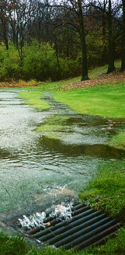
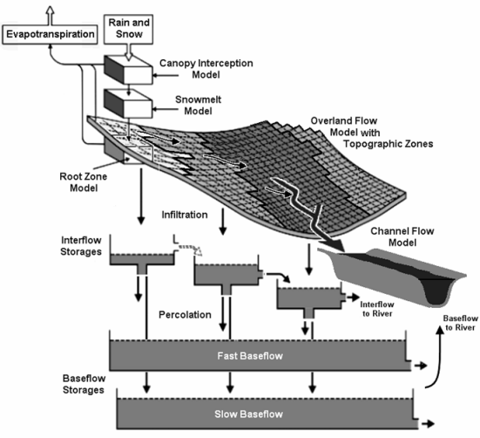
Rainfall Runoff

Slide 3
Rainfall Runoff Editor
MODELS AVAILABLE in MIKE 11 RR Module:
NAM – daily or hourly, with surface & subsurface interflow & storages, nine cal. Parameters
SMAP – monthly, with two storages, five cal. parameters (similar accuracy to monthly NAM)
UHM – unit hydrograph method using SCS or user defined curves and SCS or standard loss models
Urban – two methods: time/area or non-linear reservoir
FEH – UK Flood Estimation Handbook, with design or observed flood events
DRiFt – DEM-based morphological model developed by CIMA (Italian research cooperative)

Slide 4
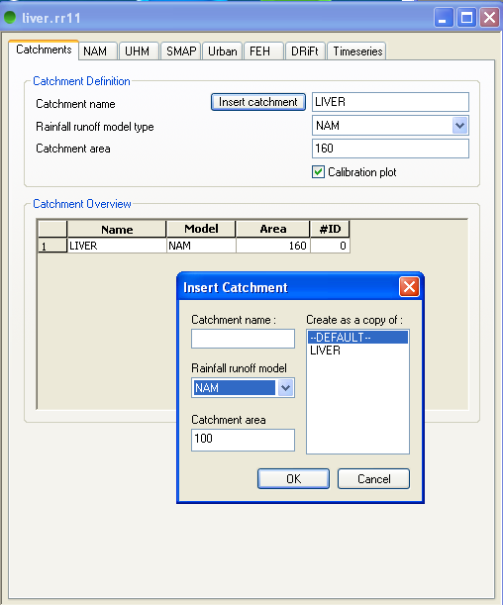
Rainfall Runoff Editor
Catchment Page
Defining Catchments
Name
Model Type
(NAM, UHM or Combined)
Area
Subcatchments for
combined catchment

Slide 5
Rainfall Runoff Editor
NAM Model
RAINFALL
POTENTIAL EVAPORATION
MODEL
PARAMETERS
RUNOFF COMPONENTS
EVAPORATION
RECHARGE

Slide 6
Rainfall Runoff Editor
NAM Model
Describes the land phase of the hydrological cycle with limited data input (precipitation, evaporation, temperature)
The NAM is a lumped, conceptual model:
lumped catchment regarded as one unit,
parameters are average values
conceptual based on considerations of the
physical processes
Similar models: Stanford, SSARR, HBV, SMAR,..

Slide 7
Rainfall Runoff Editor
NAM Model

Slide 8
Rainfall Runoff Editor
NAM Model – Types of Applications
General hydrological analysis
  Runoff distribution
  Estimates of infiltration / evaporation
Flood Forecasting
  Subcatchment inflow to river model
  Links to meteorological models
Extension of streamflow records
  Advanced gap-filling
  Improved basis for extreme value analysis etc.
Prediction of low flow
  Irrigation management
  Water quality control

Slide 9
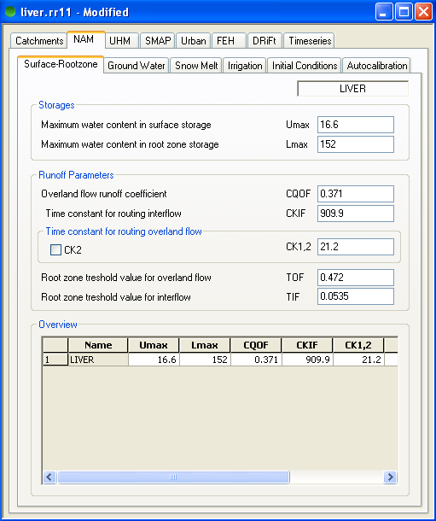
Rainfall Runoff Editor
NAM Model – Surface Rootzone Parameters
NAM Surface-Rootzone
Storages
Runoff Parameters

Slide 10
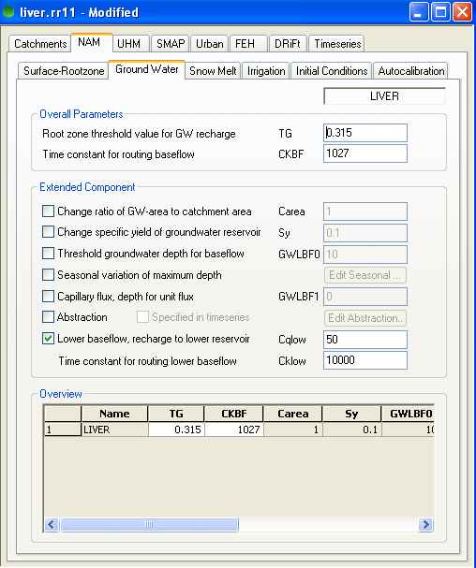
Rainfall Runoff Editor
NAM Model – Ground Water Parameters
NAM Ground Water
Overall component
Extended component
Calculation of GWL
including seasonal var.
Capilary flux
Abstraction
Lower Baseflow

Slide 11
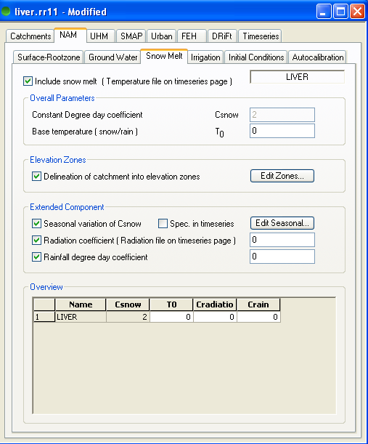
Rainfall Runoff Editor
NAM Model – Snow Melt Module
NAM Snow Melt
Simple Degree-day appr.
Advanced Snow Melt app.:
Elevation Zones
Seasonal variation of
degree-day coefficient
Radiation
Advective heat

Slide 12
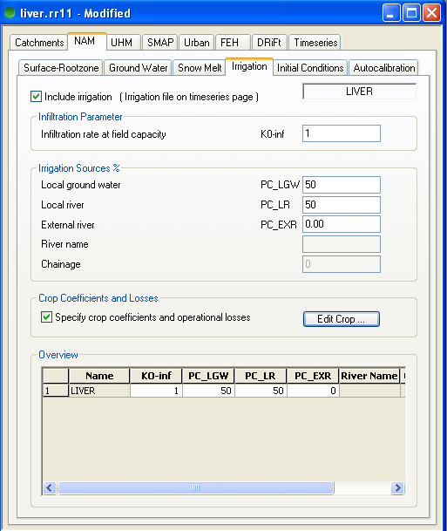
Rainfall Runoff Editor
NAM Model – Irrigation Module
NAM Irrigation
Minor Irrigation schemes
Irrigation from GW
and rivers
Crop coefficients
Losses

Slide 13
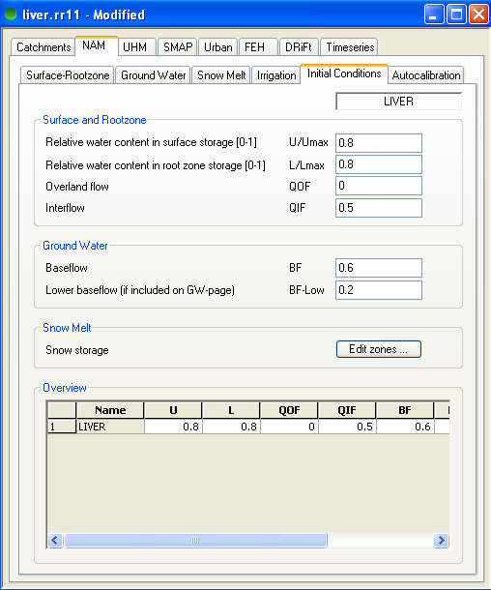
Rainfall Runoff Editor
NAM Model – Initial conditions
NAM Initial Conditions
Water Content in
Storages
Flow
Snow storage

Slide 14
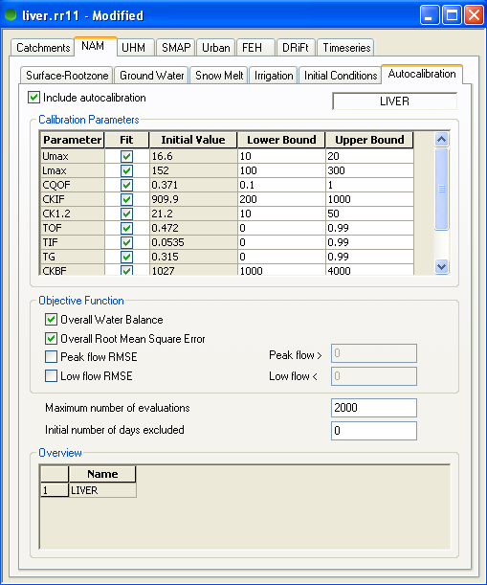
Rainfall Runoff Editor
NAM Model – Autocalibration

Slide 15
Rainfall Runoff Editor
UHM Model
UHM (Unit Hydrograph Module) constitutes an alternative to the NAM model for flood simulation in areas, where no streamflow records are available or where unit hydrograph techniques are already well established
The module includes a number of simple unit hydrograph models to estimate the runoff from single storm events
The UHM models divide the storm rainfall in excess rainfall (or runoff)
and water loss (or infiltration)
Loss Model
Constant loss
Proportional loss
SCS method
Hydrograph
SCS triangular
SCS dimensionless
User defined
Lag Time
Curve number method
User defined

Slide 16
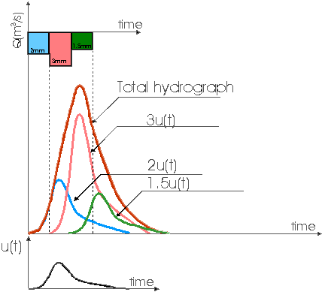
Rainfall Runoff Editor
UHM Model

Slide 17
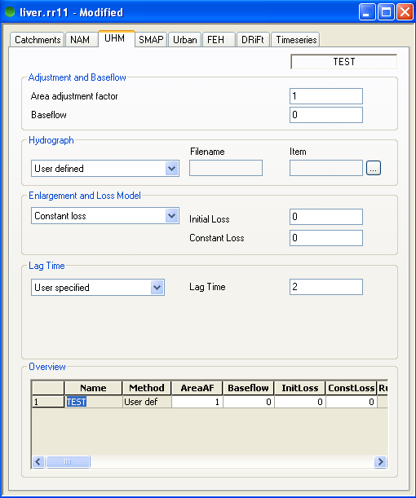
Rainfall Runoff Editor
UHM Model
Loss Model
Constant loss
Proportional loss
SCS method
Hydrograph
SCS triangular
SCS dimensionless
User defined
Lag Time
Curve number method
User defined

Slide 18
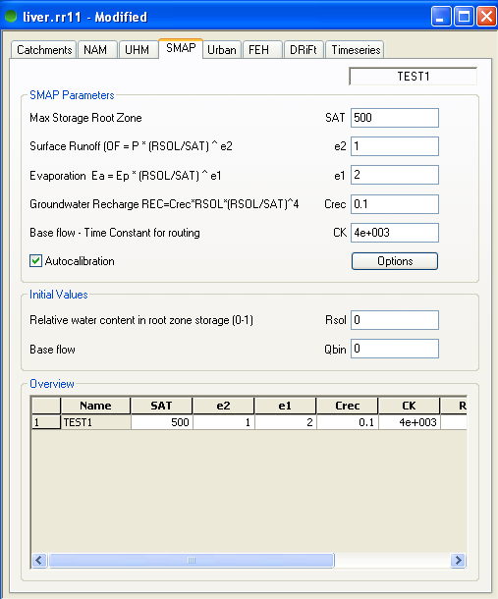
Rainfall Runoff Editor
SMAP Model
SMAP is a simple rainfall runoff model of the lumped conceptual type
It has been designed to work on the basis of monthly input data and therefore constitutes an economic alternative to the NAM model in scenarios where a daily resolution of the results is not required. This is often the case in overall water resources planning or for analyses of long term reservoir operations. In such situations data preparation time may be saved if simulations are carried out with monthly time steps only

Slide 19
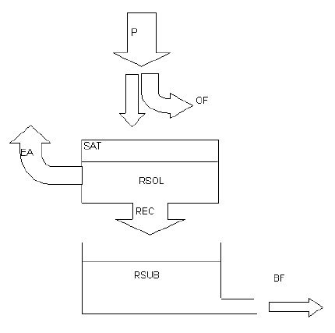
Rainfall Runoff Editor
SMAP Model
PRECIPITATION
OVERLAND FLOW
EVAPORATION
SURFACE STORAGE
RECHARGE
GROUNDWATER
STORAGE
BASE FLOW

Slide 20
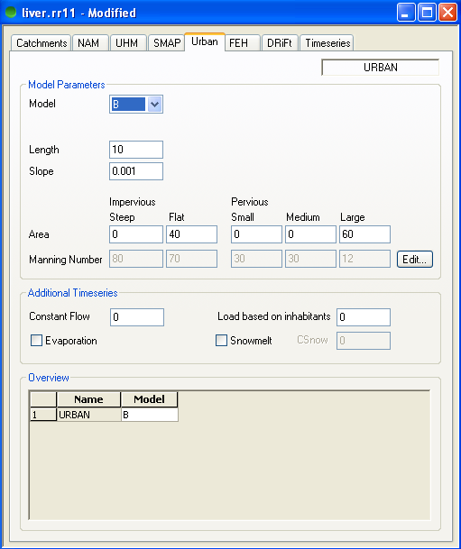
Rainfall Runoff Editor
Urban Model
Two different urban runoff computation concepts are available in the Rainfall Runoff Module :
Model A: Time/Area method
Model B: Non-linear reservoir (kinematic wave) method

Slide 21
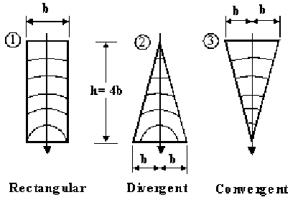
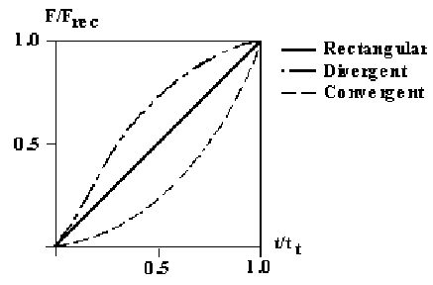
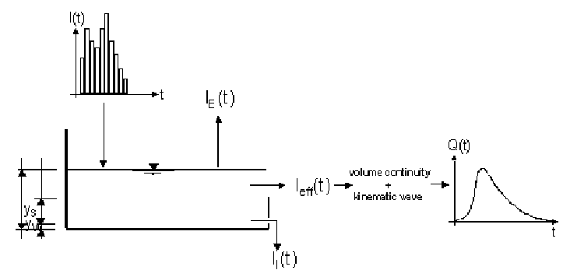
Rainfall Runoff Editor
Urban Models
Model A : Time/Area method
Catchment Shapes
Pre-Defined Time-Area Curves
Model B : Non-linear reservoir method

Slide 22
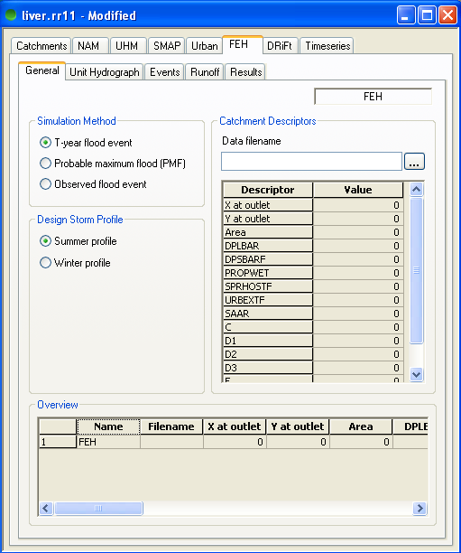
Rainfall Runoff Editor
FEH Model (Flood Estimation Handbook)
FEH was introduced in 1999 to replace the previous Flood Studies Report (FSR) methods for flood estimation in the UK
The FEH comes in 5 volumes
The FEH set comprises:
Overview
Rainfall Frequency Estimation
Statistical Procedures for Flood Frequency estimation
Restatement and application of the Flood Studies Report rainfall-runoff method
Catchment Descriptors

Slide 23
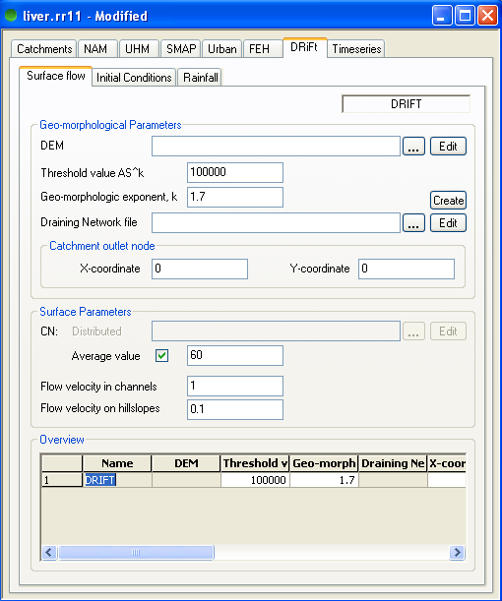
Rainfall Runoff Editor
DRIFt Model (Additional module required)
The DRiFt module (DRiFt = Discharge River Forecast) is a semi-distributed rainfall-runoff model based on a morphological approach.
The model is able to consider the topography of each site analyzed and the spatial variability of soil characteristics and rainfall patterns.
Input data for the DRiFt model is divided into three groups:
Surface Flow parameters
Initial Conditions
Rainfall / Precipitation data

Slide 24
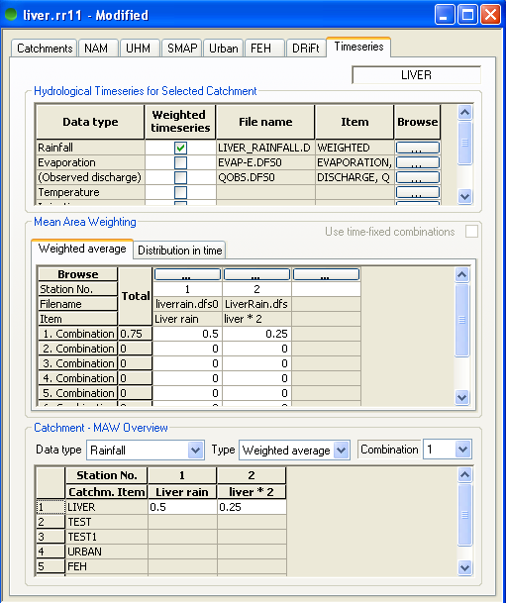
Rainfall Runoff Editor
Time Series Input Page
The Time series page serves two purposes: Input of time series and calculation of weighted time series
Setup of input
timeseries (boundaries)
Observed discharge incl.
in the timeseries list when
calibrating the model
Mean Area Weighting
Weighted average
Distribution in time
Automatic calculation

Slide 25
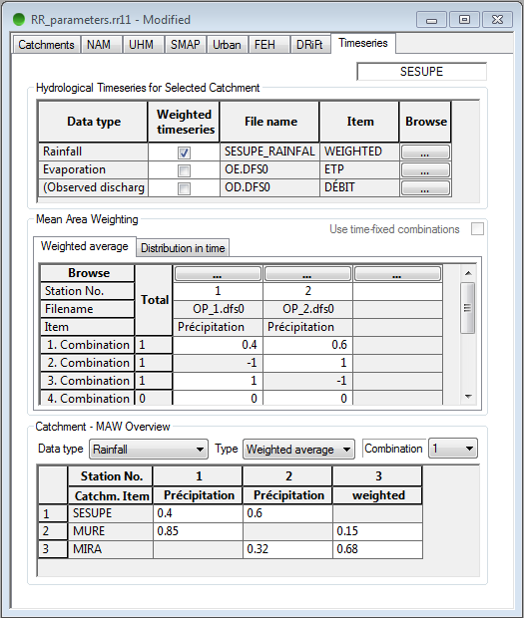
Rainfall Runoff Editor
Time Series Input Page – Weighting function
Weighting is activated by ticking the box in the upper table
Add the necessary time series in the “Mean Area Weighting” table, with associated weighting factors
Gaps may be handled with weighting factor “-1” (not mandatory)
The lower table provides an overview of factors for the various catchments

Slide 26
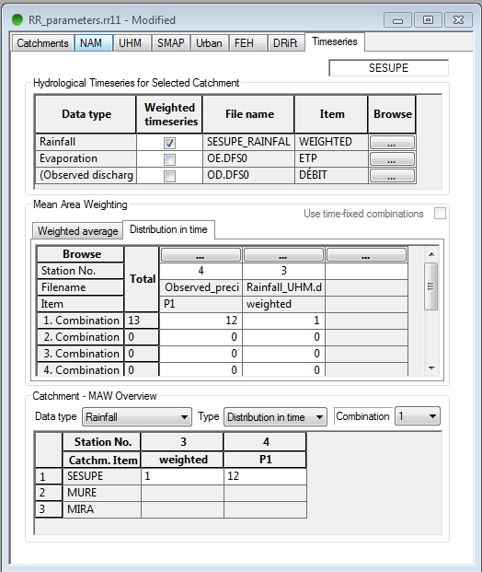
Rainfall Runoff Editor
Time Series Input Page – Weighting function
The “Distribution in time” may be used when input time series provide observed data with different frequencies
Input time series are hence weighted according to their frequency

Slide 27
Rainfall Runoff Editor
Time Series Input Page – Weighting function
The weighted output time series may be generated:
Manually by using the “Calculate mean precipitation” feature (Basin Work Area menu)
Automatically when simulation starts

Slide 28
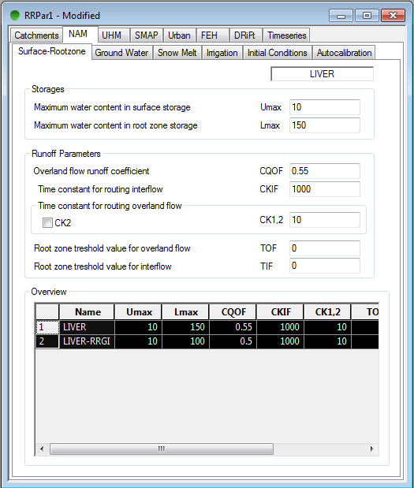
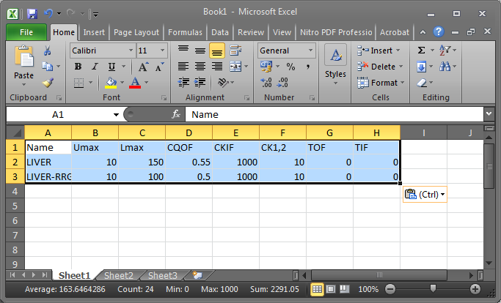
Rainfall Runoff Editor
Possibility to use a spreadsheet when editing parameters
(copy and paste)

Slide 29
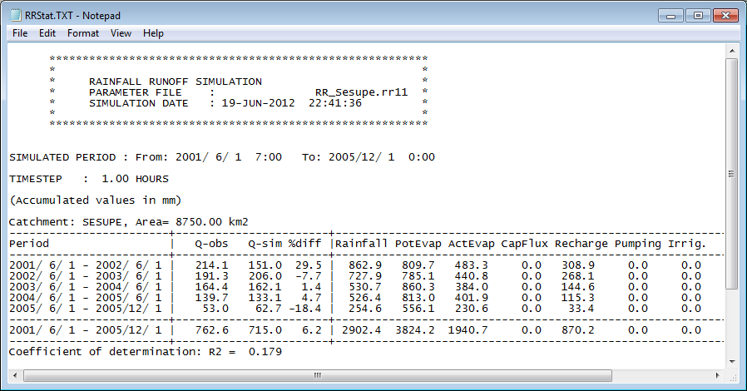
Rainfall Runoff Editor
Statistical Output File:
Accumulated
water balances
Comparison of
simulated and
observed Q
Coefficient of
determination

Slide 30
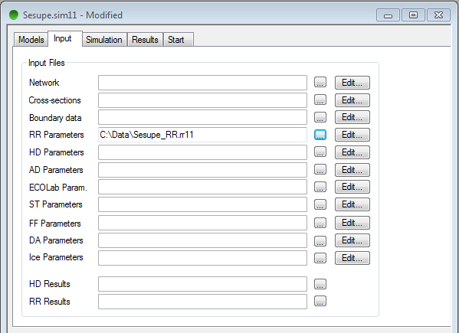
Rainfall Runoff Editor
Setup of Rainfall Runoff simulation
Input:
RR parameter file
No boundary file specified:
Time series in rainfall
runoff editor.

Slide 31
Rainfall Runoff Editor
Inclusion of Runoff results in River model:
RR-simulation (produce RR Result-file)
Specify Catchment definitions in Network Editor
(input to single points or distributed along reach)
Specify RR Result-filename in Simulation Editor

